Slide 1




Introduction to Text-to-Speech Technology
AWS Polly
ReactJS
A cloud service that converts text into natural, human-like speech with multiple voices and languages.
A popular JavaScript library that builds responsive and dynamic user interfaces for web applications.
AWS SDK
Enables frontend applications to securely interact and communicate with AWS services, facilitating smooth integration.
Together, these technologies provide high-quality voice synthesis and scalable performance with an interactive, user-friendly interface.

Slide 2
Problem Statement: Accessibility and Engagement
Accessibility Barriers
Engagement Issues
Existing Solutions
Globally, 285 million visually impaired people face challenges accessing textual information.
Low engagement with text-heavy content limits learning, with most readers spending about 2 minutes on articles.
Current TTS systems can be expensive, complex, or lack user-friendly customization options for diverse users.
Addressing these obstacles with an affordable, accessible, and interactive tool is critical to improve information delivery and learning effectiveness.

Slide 3





Objective: Building an Accessible and Engaging Solution
High-Quality Audio Output
Customization
Multi-Language Support
Deliver lifelike, clear speech synthesis using AWS Polly voices.
Allow users to adjust speed, pitch, and volume for personalized listening experiences.
Include various languages and voice options to suit diverse audiences.
User-Friendly Interface
Playback & Download
Design an intuitive frontend with real-time conversion and audio playback or download options.
Users can listen online or save audio files.

Slide 4





System Architecture: Overview
User Input
Text and voice choices entered in ReactJS UI
API Gateway
Sends requests securely to backend services
AWS Polly
Converts text to speech with chosen parameters
Response
Audio file returned to frontend
Playback/Download
User plays audio or downloads the MP3

Slide 5
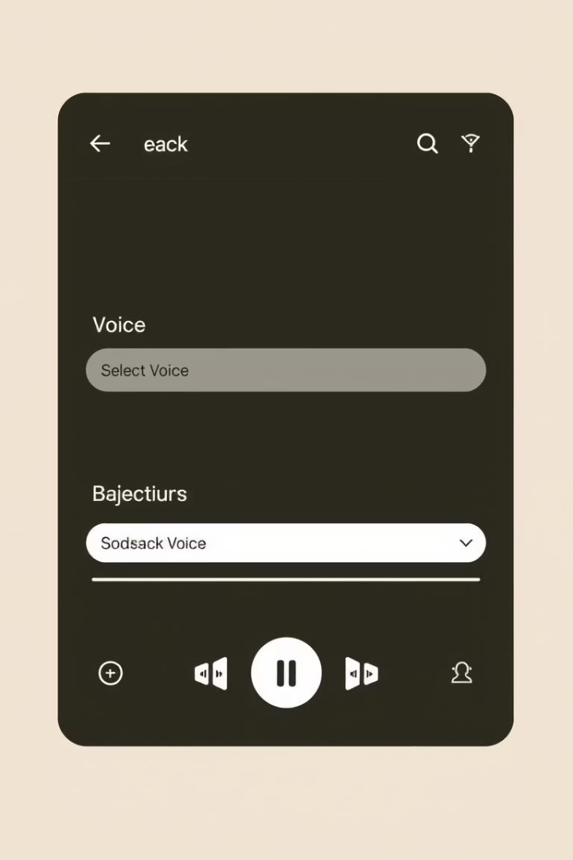
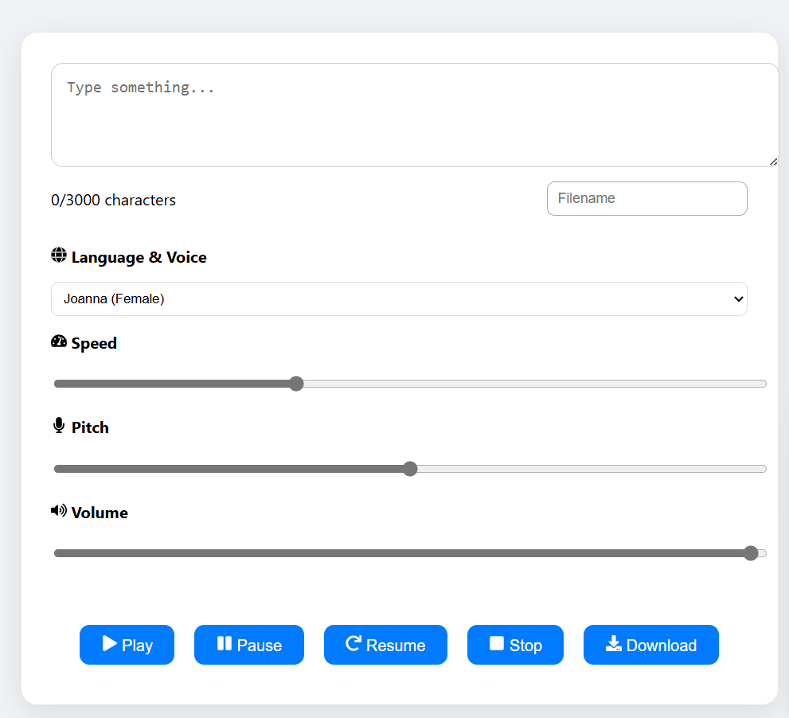


Implementation Details: Frontend (ReactJS)
UI Components
State Management
Includes text input, voice selection dropdowns, and audio playback buttons for user control.
Tracks input text, chosen voice, pitch, speed, and playback status using React’s useState hook.
API Integration
Sends requests to backend via AWS API Gateway, handling responses with Axios or Fetch and displaying errors gracefully.
The frontend delivers a clean, interactive experience with customizable audio options and real-time feedback.

Slide 6
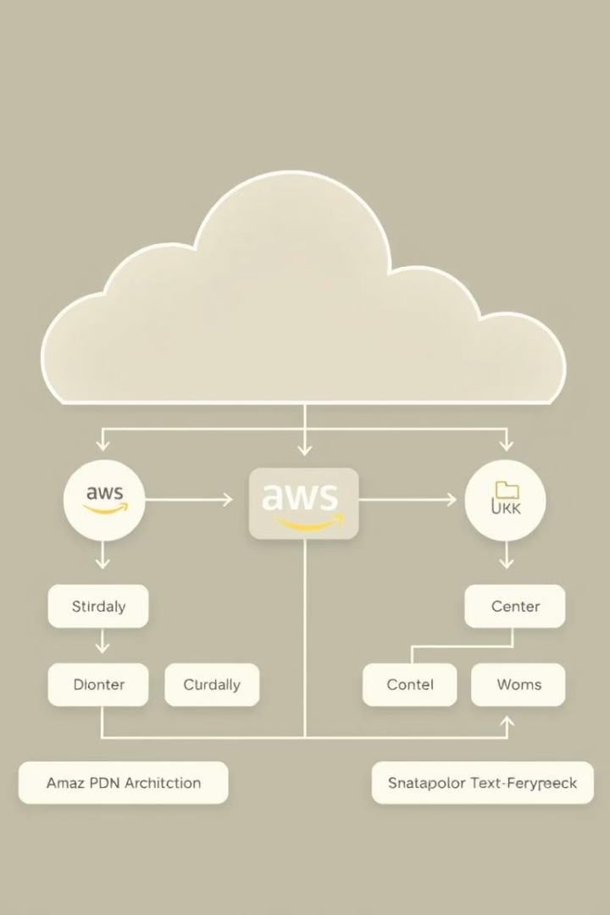
Implementation Details: Backend (AWS Services)
Request Handling
Using AWS SDK
Receives text and voice parameters from frontend securely.
Calls Polly’s SynthesizeSpeech API with configured voice, output format (MP3), and customization options.
Audio Delivery
Returns generated audio file to frontend for immediate playback or download.
This backend workflow ensures efficient, scalable, and reliable audio synthesis on demand.

Slide 7







Key Features and Benefits
Multiple Voices
Real-Time Playback
Custom Controls
Male, female, and multilingual voice options.
Instant speech output for any text.
Adjust speed, pitch, and volume easily.
Downloadable Files
Pause ,resume
Input Format
Save audio as MP3.
Pause,resume options
Various input options

Slide 8
References and Resources
AWS Polly Docs
https://aws.amazon.com/polly/
ReactJS Official
https://react.dev/
AWS SDK for JavaScript
https://aws.amazon.com/sdk-for-javascript/
Github Repository
Link to project source code and examples

Slide 9





Conclusion: Empowering Communication and Accessibility
Bridging Gaps
Text-to-speech technology fosters inclusivity, breaking communication barriers for varied users.
Integrated Power
Combining AWS Polly, ReactJS, and AWS SDK creates a robust, scalable solution for today’s needs.
Future Enhancements
Plans include expanded languages, deeper voice customization, and integration with broader accessibility tools.
Call to Action
Embrace accessible design principles to foster a more inclusive digital future for all users.

Slide 10
Project Images:
1.Homepage:

Slide 11
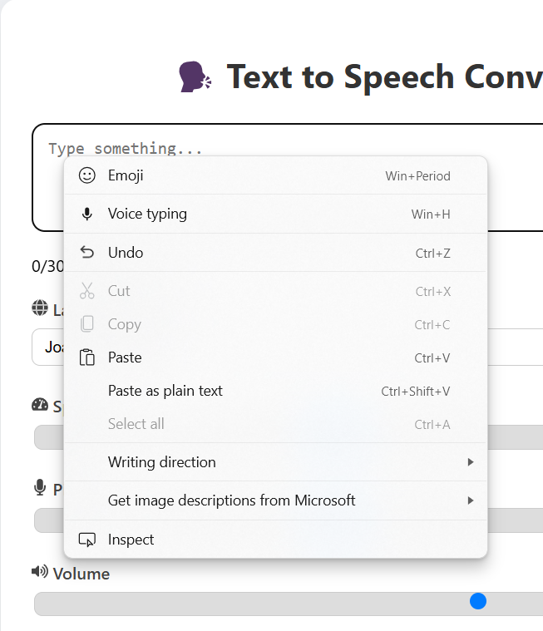
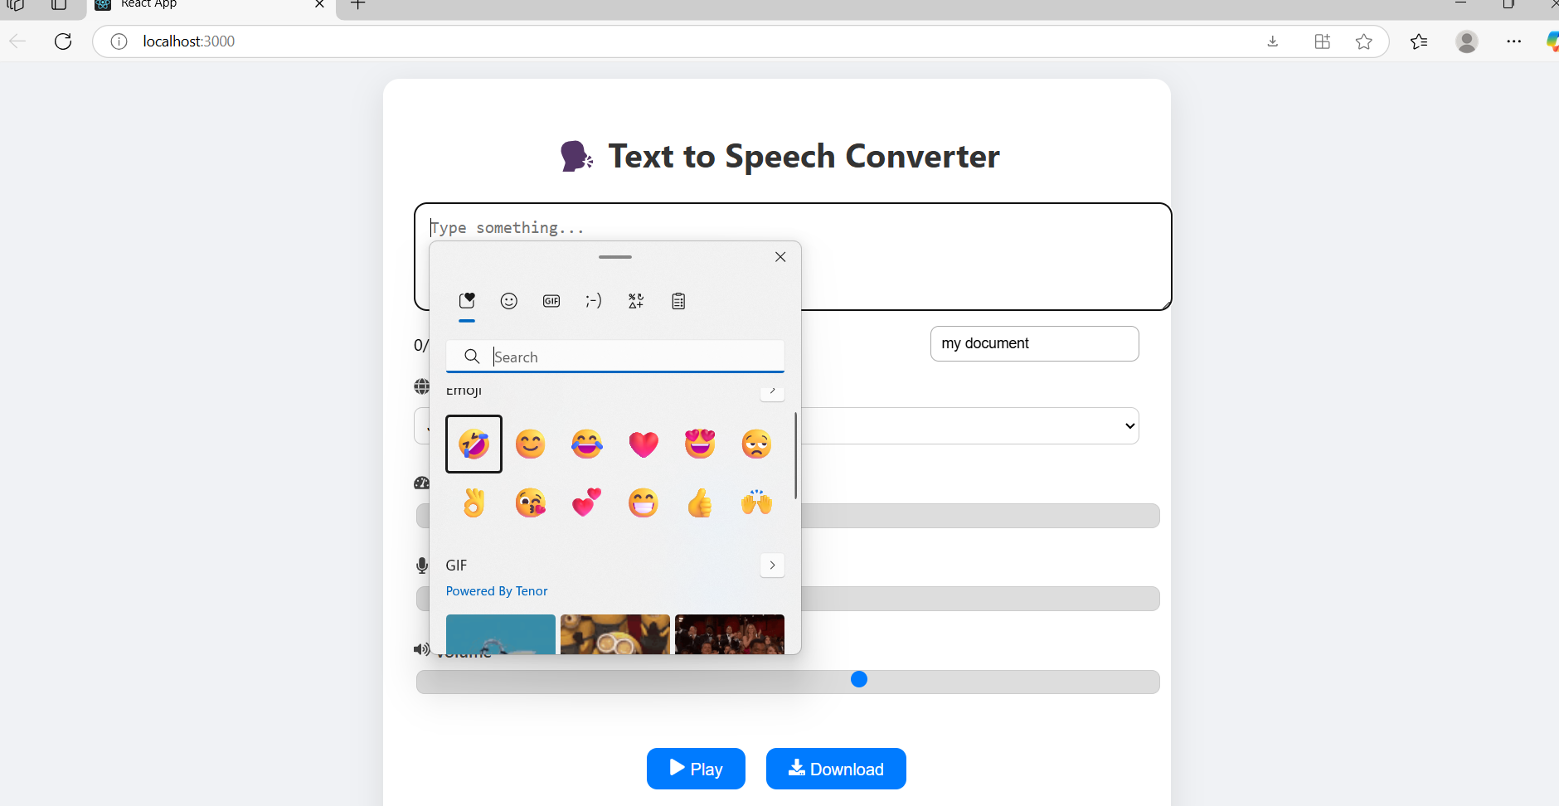
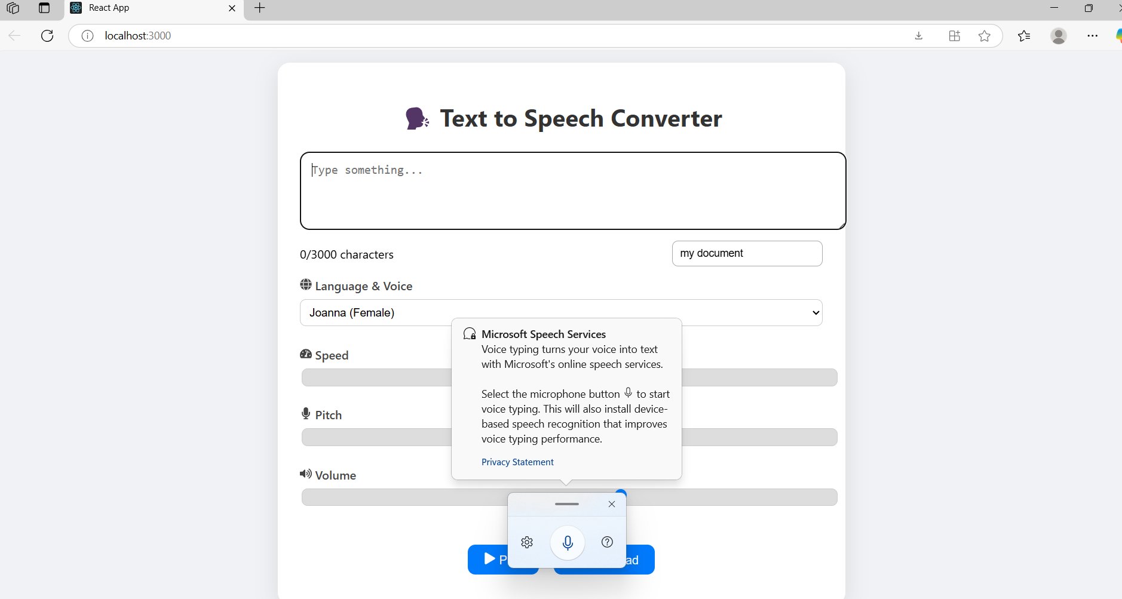
2.Input Options

Slide 12
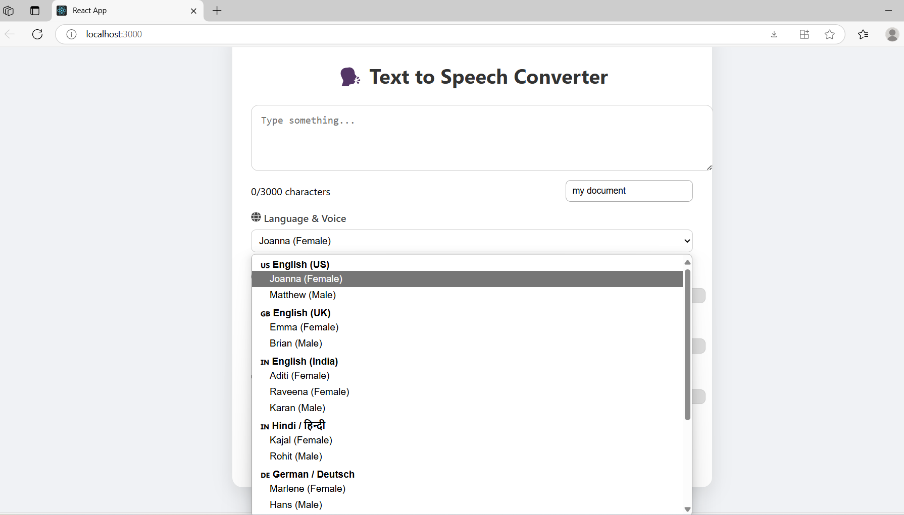
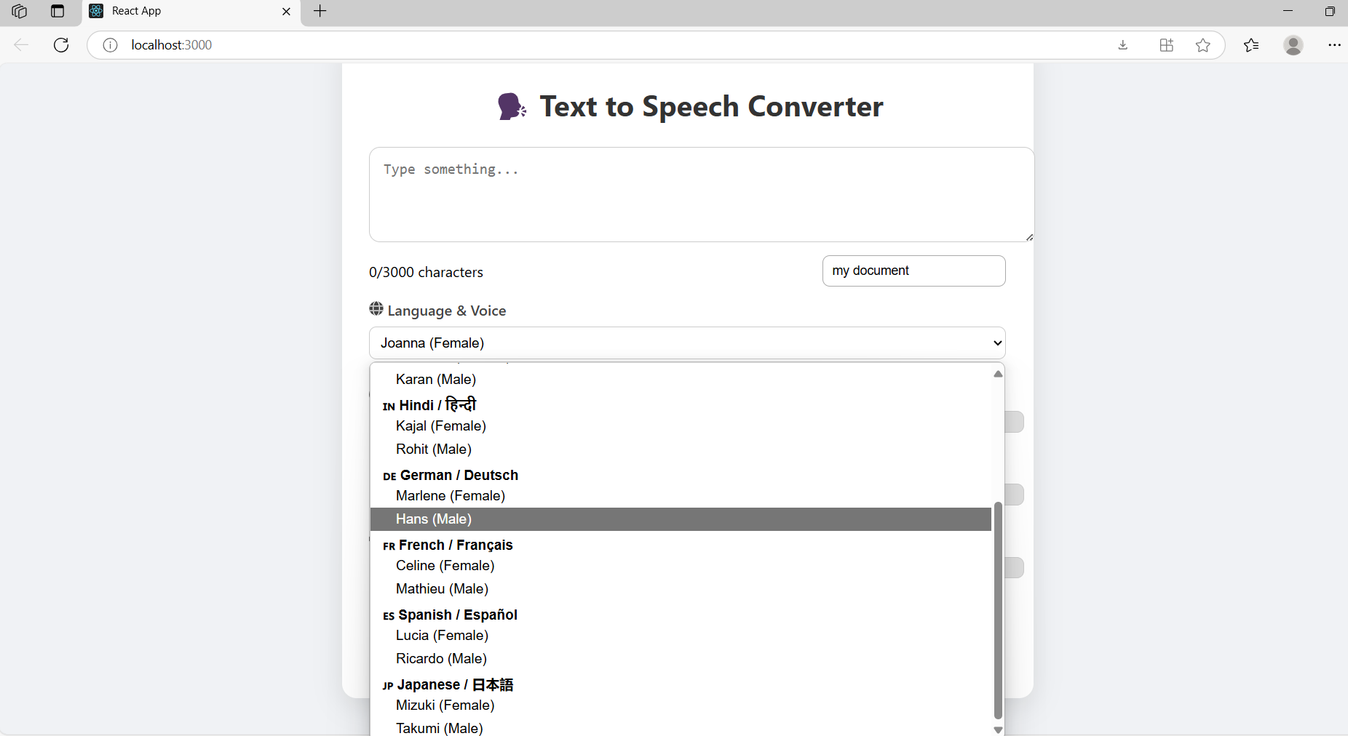
3.Language Options

Slide 13
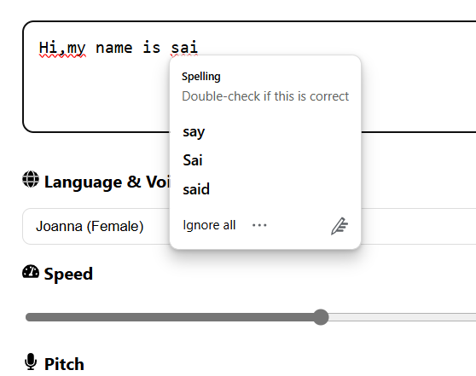
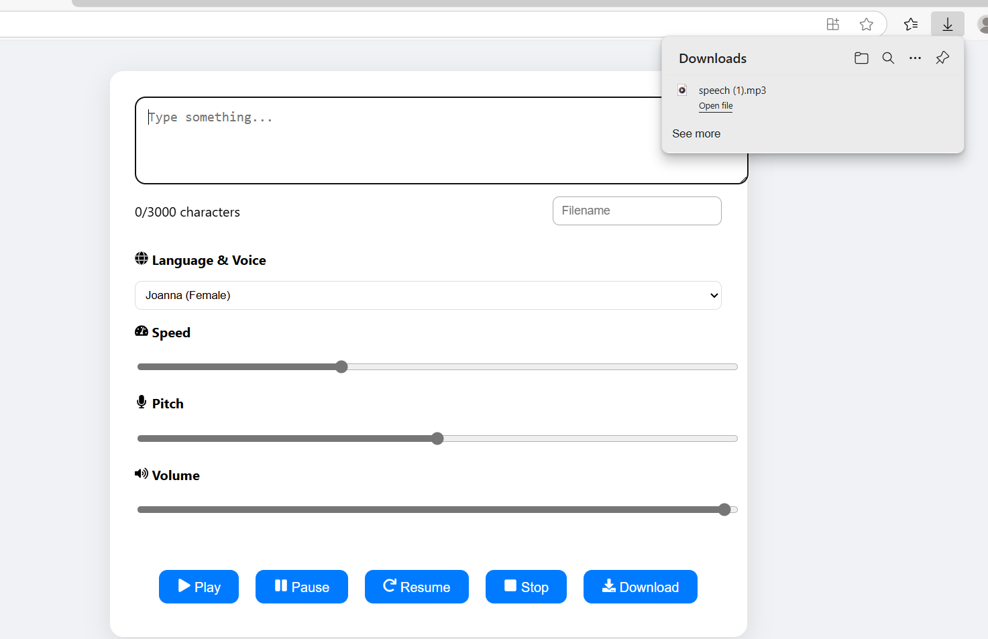
4.Features

Slide 14
Thank You…!

